Slide 1

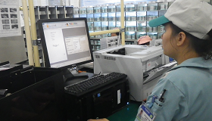
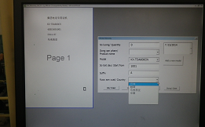
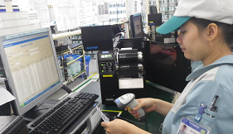
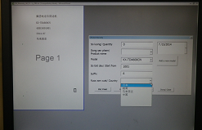

Quality
Quality
To kaizen at printing warranty label process in FA
Line: INTEM
PIC: Ms Ly – [Officer]
Date:Jul 16th 2014
Expn: 0 $
Đinh Thị Lý
2000637
◆Before
◆ After
Manual
Automatic
To print warranty label of CN models, operator have to input data by choosen items of software. Letter is Chinese, it is difficult to recognize, easy to make mistake
By using Barcode reader read barcpde, model's name will appear, computer will link the warranty label's data automatically→printing

Slide 2
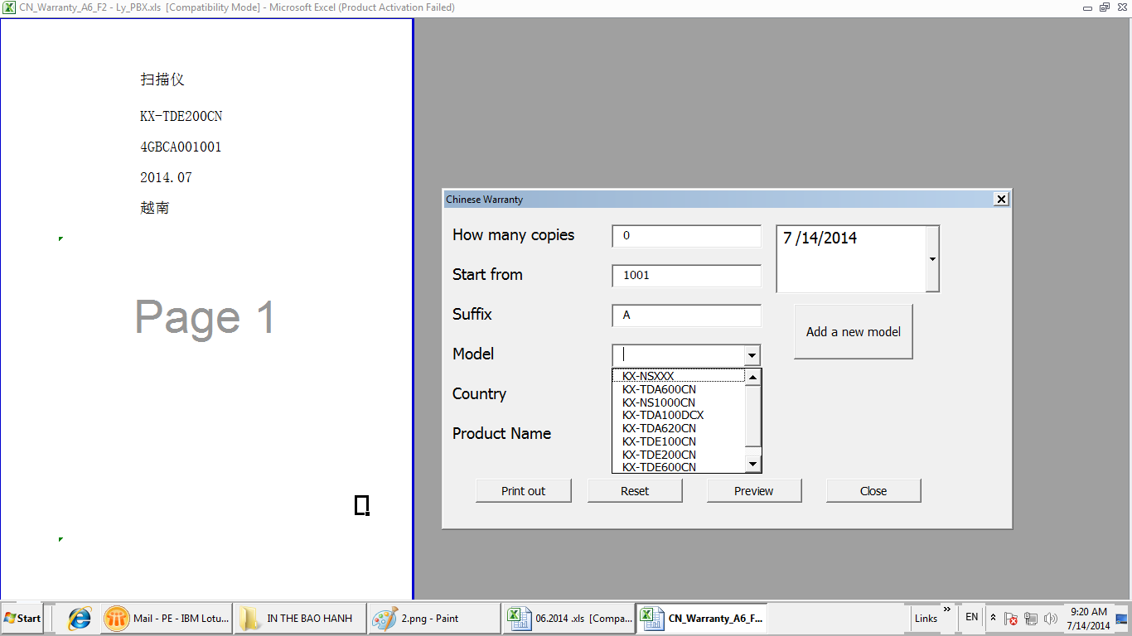
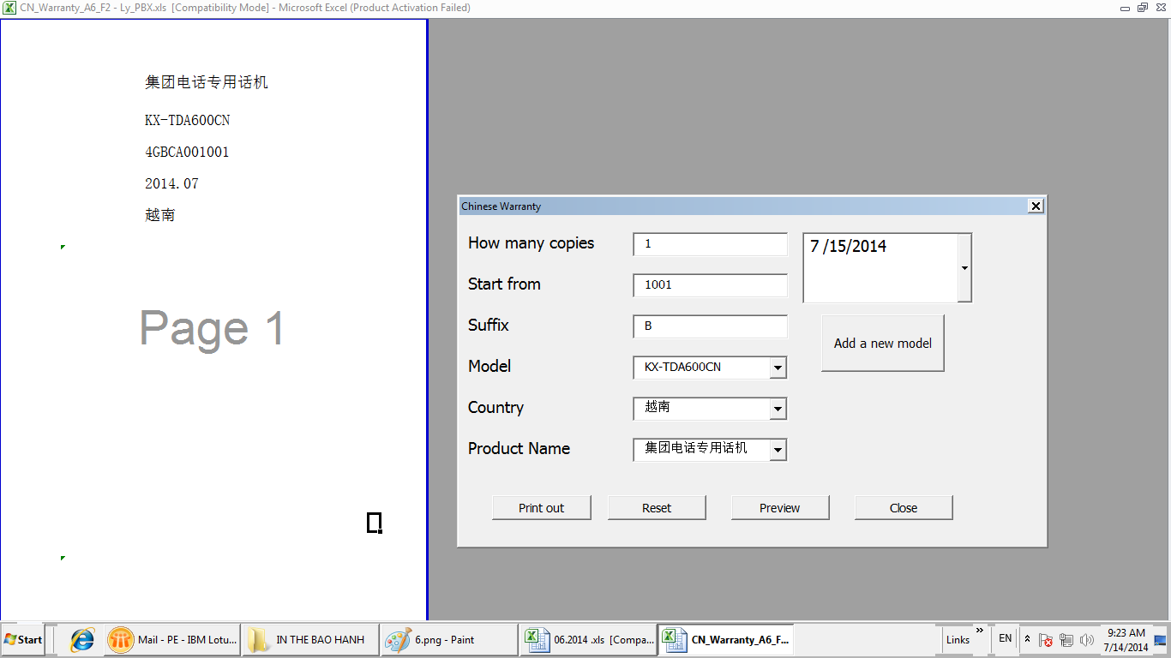

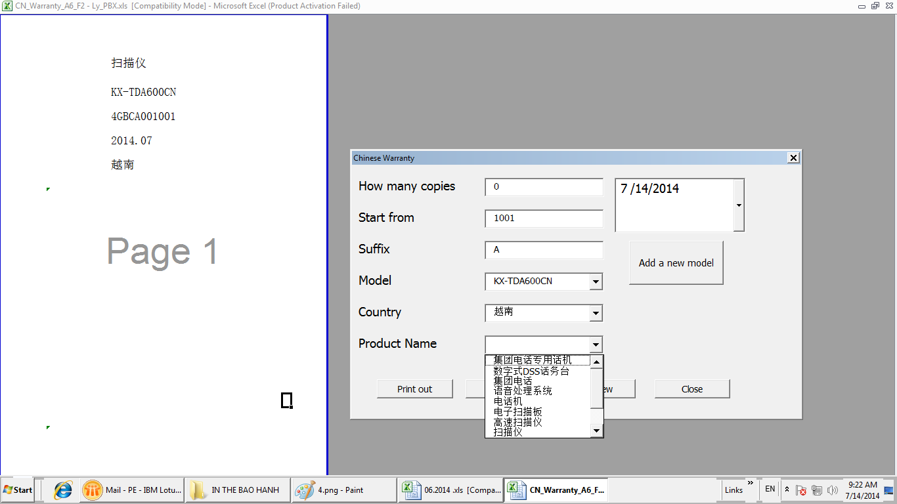
Using Barcode reader barcode
Only click to choose model
Automatic
Appear : Country, Product name

